Slide 1
Employee Attrition Analytics
DATA SCIENCE PRODEGREE PROJECT
Shipra Agarwal
Kratika Bhargava
Seema Paliwal
Satyendra Rao
Sorabh Sharma
Ashish Pradhan

Slide 2
ABSTRACT
The project gives an overview of the attrition analysis for a consulting firm and allows you to understand and identify factors that help in retaining employees.

Slide 3
Objective: This model predicts the following details:
Identify the factors influencing attrition
Predict possible attrition
Identify possible ways to retain high perform

Slide 4
Steps followed :
Understand the Problem and Objective
Understand the Data and Develop some Business Sense
EDA
Data Cleaning & Preparation
Feature Engineering
Model Building with various Techniques and justification
Testing and Cross-Validation
Final results recommendations and Plots/Visualizations

Slide 5
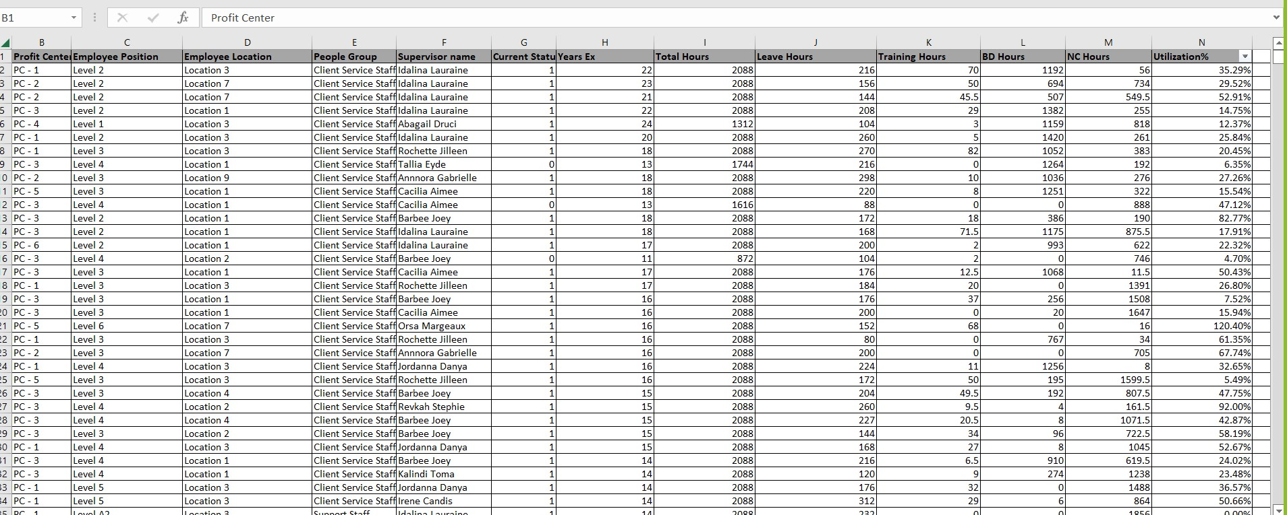
We considered this Data in our project

Slide 6
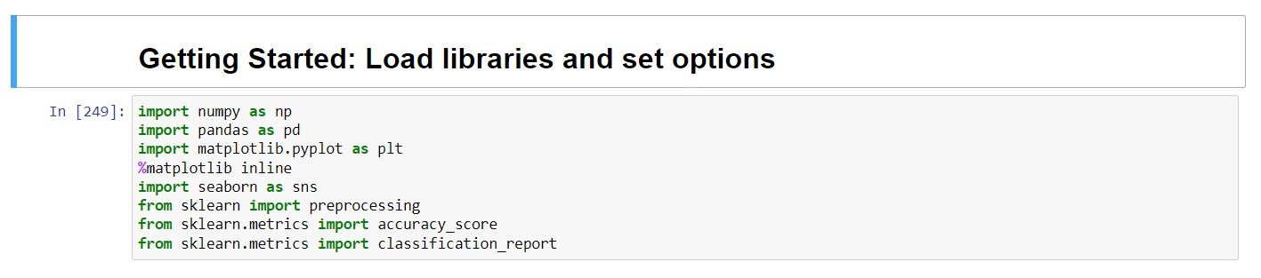
Open IDE and get started with load libraries

Slide 7
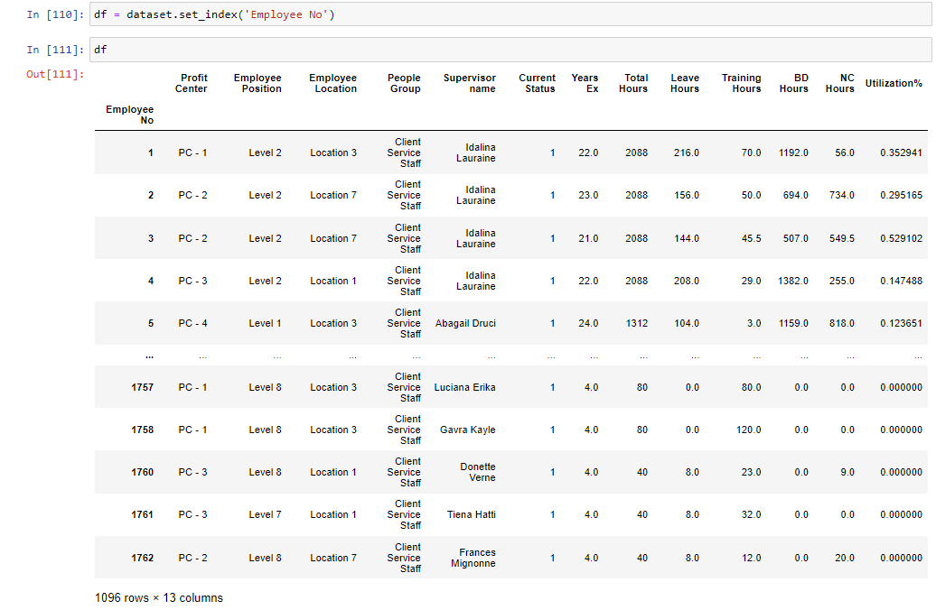
Data load & Indexing

Slide 8
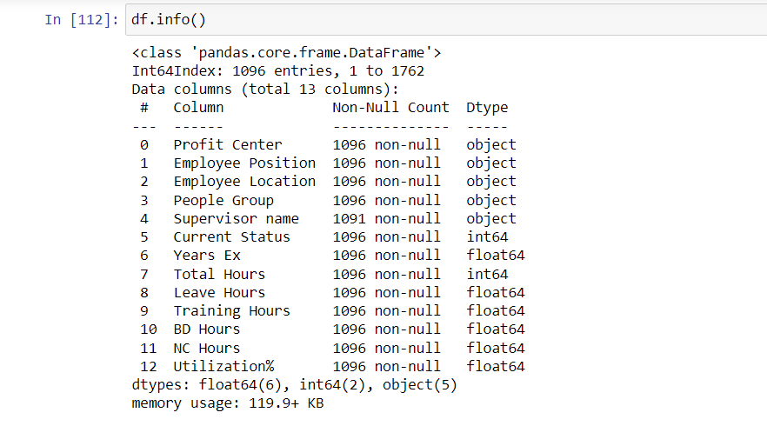

Slide 9
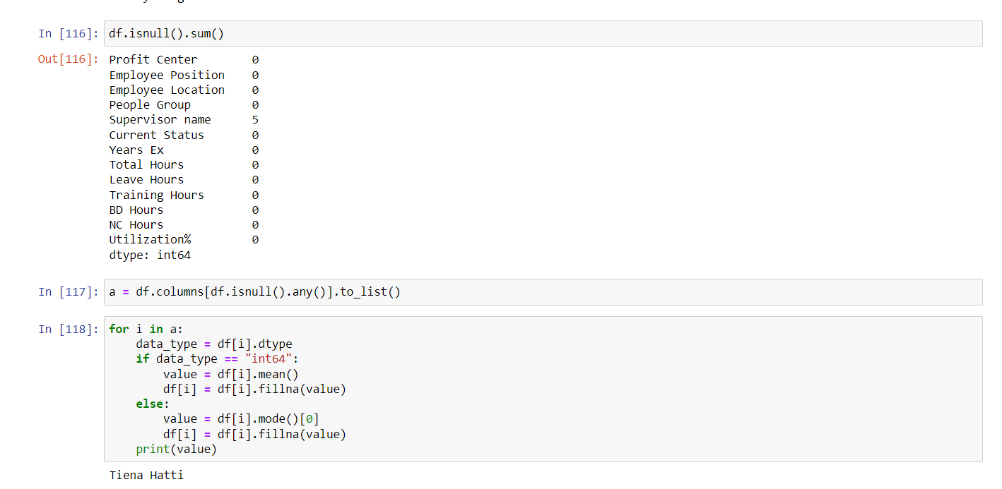

Slide 10
Exploratory Data Analysis
EDA is used to better understand data, find clues about the tendencies of the data, and its quality, and formulate assumptions and the hypothesis of our analysis
For data preprocessing to be successful, it is essential to have an overall picture of the data Basic statistical descriptions can be used to identify the properties of the data and highlight which data values should be treated as noise or outliers.
The next step is to explore the data. We have used two approaches used to examine the data using:
Descriptive statistics is the process of condensing key characteristics of the data set into simple numeric metrics. Some of the common metrics used are mean, standard deviation, and correlation.
Visualization is the process of projecting the data, or parts of it, into Cartesian space or into abstract images. In the data mining process, data exploration is leveraged in many different steps including preprocessing, modeling, and interpretation of results.

Slide 11
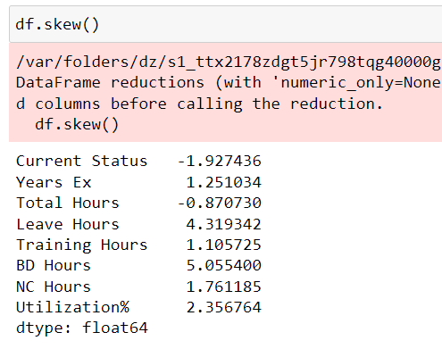
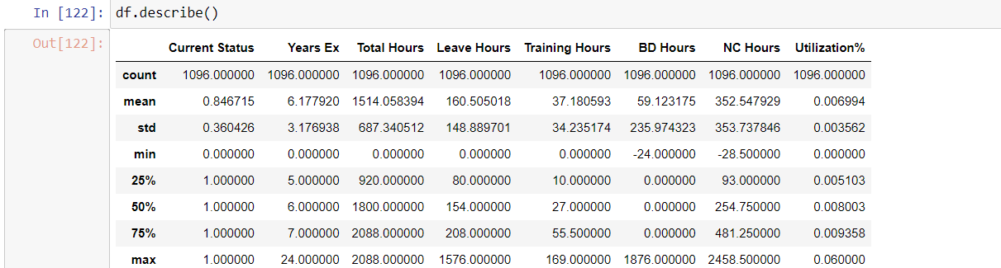

Slide 12
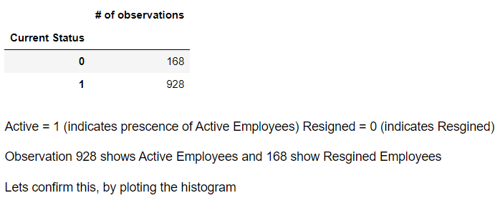
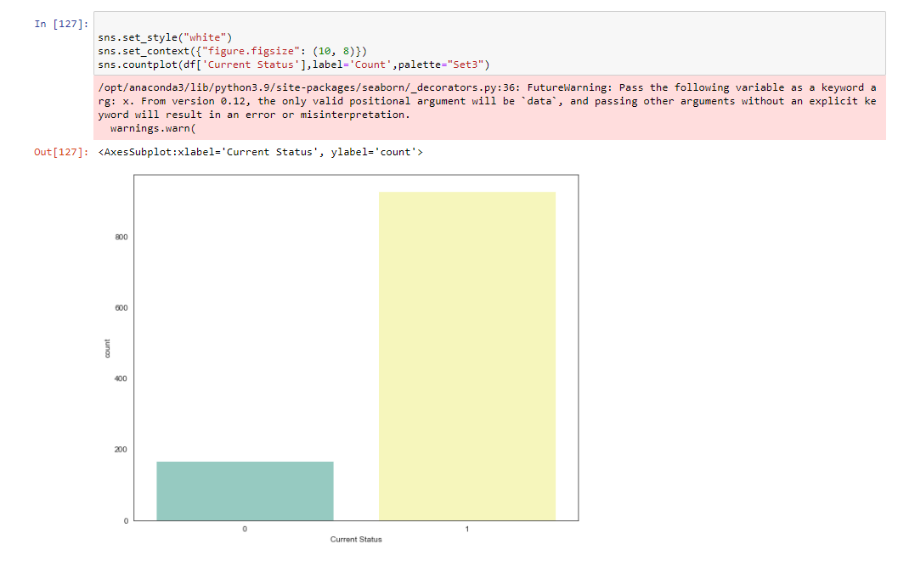
Unimodal Data Visualizations

Slide 13
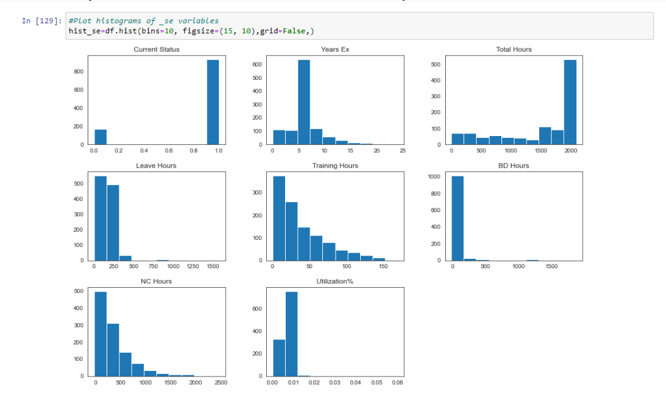
Separate columns into smaller data frame to perform visualization

Slide 14
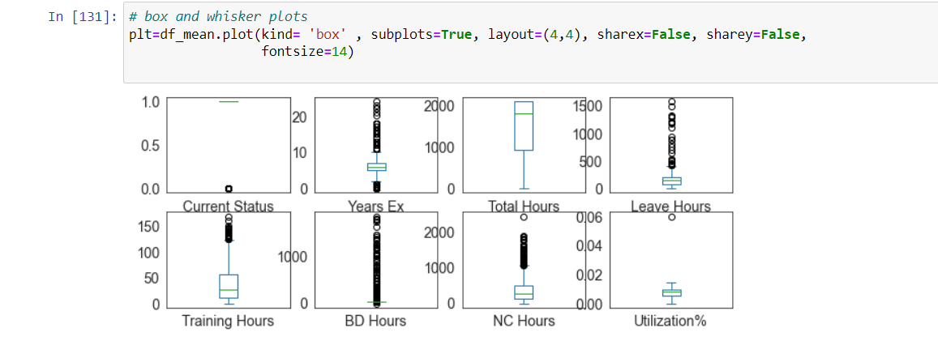
Visualize the distribution of data via density plots

Slide 15
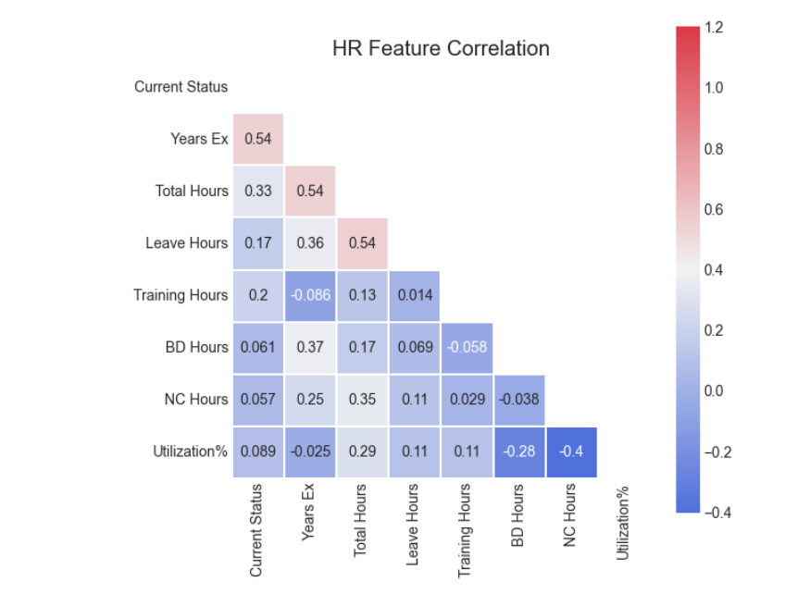
Multimodal Data Visualizations Scatter plots Correlation matrix

Slide 16
Pre-Processing the data
Goal: Find the most predictive features of the data and filter it so it will enhance the predictive power of the analytics model.

Slide 17
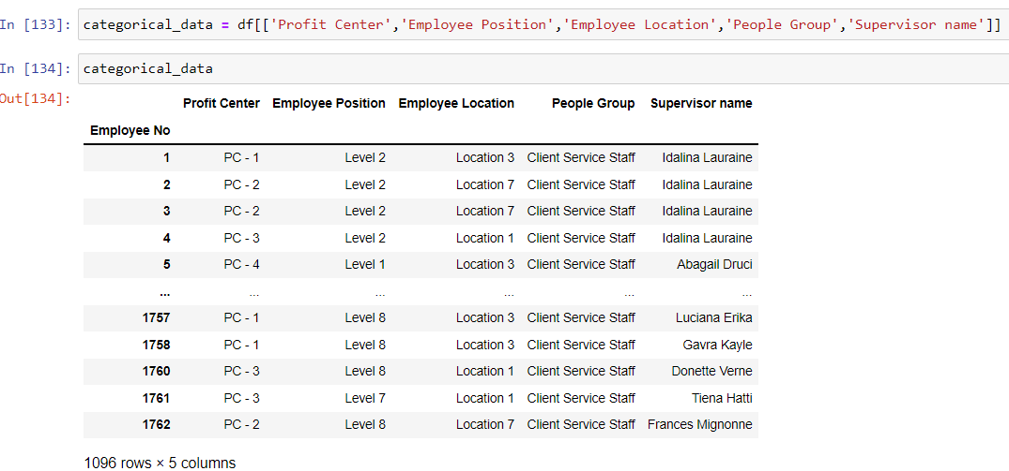
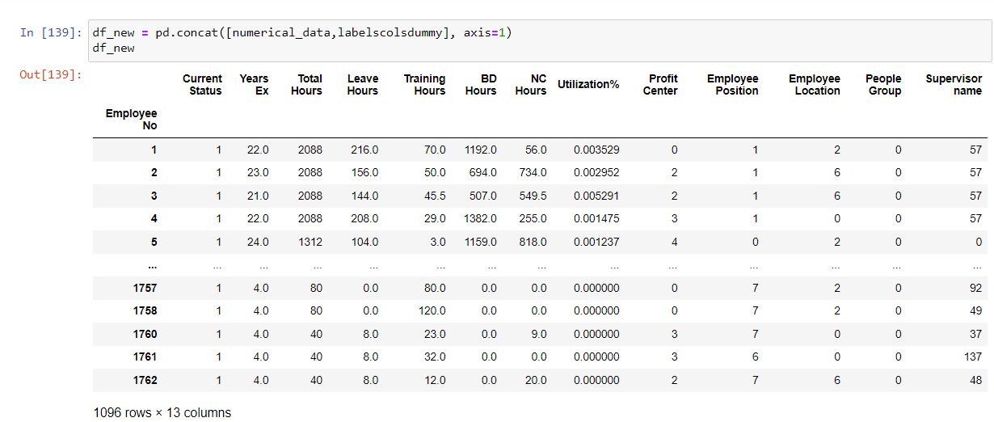
Label encoding

Slide 18
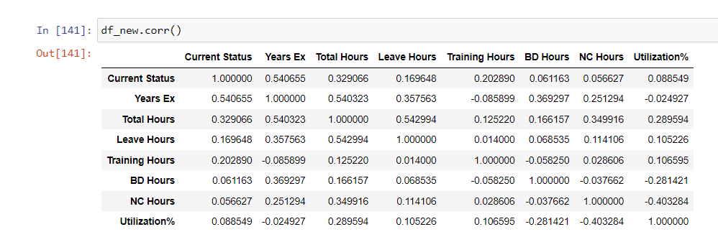
Correlation Matrix

Slide 19
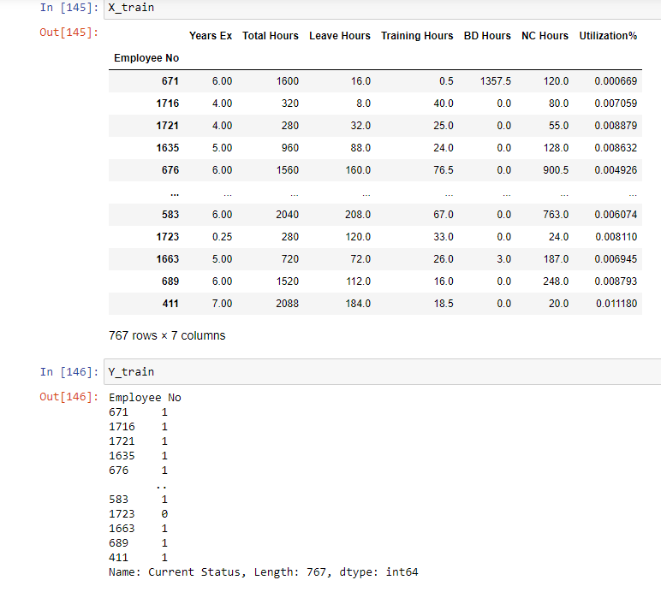
Split data into training and test sets

Slide 20
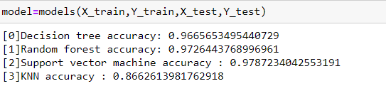
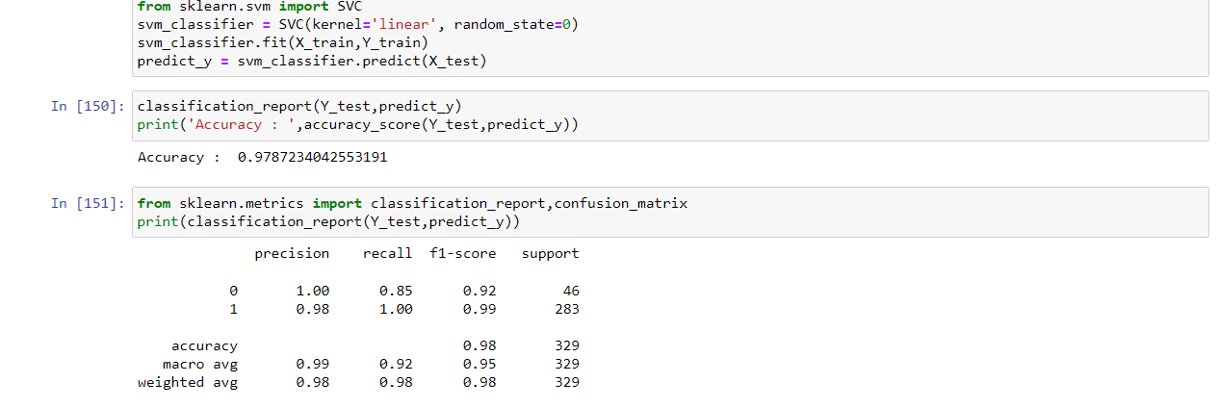
Algorithm used and model accuracy

Slide 21
